Slide 1

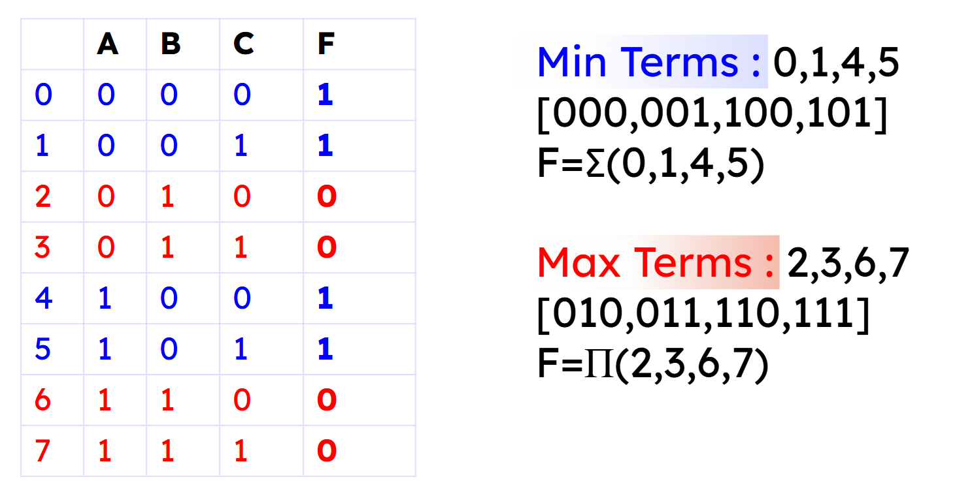
Department of Computer Science and Engineering, BRAC University
Lecture 4
SOP & POS
CSE260 : Digital Logic Design

Slide 2


SOP & POS
Sum-of-Products (SOP) Expression:
A product term or a logical sum (OR) of several product terms.
Example: x+yz', xy'+x'yz, AB+A'B’
Product-of-Sums (POS) Expression:
A sum term or a logical product (AND) of several sum terms.
Example: x(y+z'), (x+y')(x'+y+z), (A+B)(A'+B’)
‹#›
Department of Computer Science and Engineering
CSE260 - Digital Logic Design

Slide 3
SOP & POS [Cont.]
Every boolean expression can either be expressed as sum-of-products or product-of-sums expression.
Example:
SOP: x’y + xy’ + xyz
POS: (x + y’)(x’ + y)(x’ + z’)
‹#›
Department of Computer Science and Engineering
CSE260 - Digital Logic Design

Slide 4
MIN & MAX TERM
‹#›
Department of Computer Science and Engineering
CSE260 - Digital Logic Design

Slide 5
MIN & MAX TERM
Minterms are sum terms.
For Boolean functions, the minterms of a function are the terms for which the result is 1.
Boolean functions can be expressed as sum- of-Minterms.
Maxterms are Product terms.
For Boolean functions, the maxterms of a function are the terms for which the result is 0.
Boolean functions can be expressed as Products-of-Maxterms.
‹#›
Department of Computer Science and Engineering
CSE260 - Digital Logic Design

Slide 6
MIN & MAX TERM
 | A | B | C | F
0 | 0 | 0 | 0 | 1
1 | 0 | 0 | 1 | 1
2 | 0 | 1 | 0 | 0
3 | 0 | 1 | 1 | 0
4 | 1 | 0 | 0 | 1
5 | 1 | 0 | 1 | 1
6 | 1 | 1 | 0 | 0
7 | 1 | 1 | 1 | 0
Min Terms : 0,1,4,5 [000,001,100,101] F=∑(0,1,4,5)
Max Terms : 2,3,6,7 [010,011,110,111] F=Π(2,3,6,7)
‹#›
Department of Computer Science and Engineering
CSE260 - Digital Logic Design

Slide 7
MIN-SOP and MAX-POS
 | A | B | C | F
0 | 0 | 0 | 0 | 1
1 | 0 | 0 | 1 | 1
2 | 0 | 1 | 0 | 0
3 | 0 | 1 | 1 | 0
4 | 1 | 0 | 0 | 1
5 | 1 | 0 | 1 | 1
6 | 1 | 1 | 0 | 0
7 | 1 | 1 | 1 | 0
Min Terms : 0,1,4,5 [000,001,100,101]
F=∑(0,1,4,5)
F=A’B’C’+A’B’C+AB’C’+AB’C
Max Terms : 2,3,6,7 [010,011,110,111] F=Π(2,3,6,7)
F=(A+B’+C)(A+B’+C’)(A’+B’+C) (A’+B’+C’)
Min/SOP
0-Prime, 1-No prime
AND among literals
OR among terms
Max/POS
1-Prime, 0-No prime
OR among literals
AND among terms
‹#›
Department of Computer Science and Engineering
CSE260 - Digital Logic Design

Slide 8
Conversion of Function to
SOP & POS
‹#›
Department of Computer Science and Engineering
CSE260 - Digital Logic Design

Slide 9
How to Convert into SOP
Steps
Check if each term contains all variable,
if not then AND (x+x’) if x is the missing term
Remove the duplicates
‹#›
Department of Computer Science and Engineering
CSE260 - Digital Logic Design

Slide 10
How to Convert into SOP
Example:
F(A,B,C)=A+B’C
=A (B+B’) (C+C’) + B’C(A+A’)
=(AB+AB’) (C+C’) + B’C(A+A’)
=AB(C+C’) + AB’(C+C’) + B’C(A+A’)
=ABC + ABC’ + AB’C + AB’C’ + B’CA + B’CA’
Now, removing duplicates and writing the literals in order,
=ABC + ABC’ + AB’C + AB’C’ + A’B’C
= 111, 110, 101, 100, 001
=∑(1,4,5,6,7)
‹#›
Department of Computer Science and Engineering
CSE260 - Digital Logic Design

Slide 11
How to Convert into POS
Steps
Apply distributive law (x+yz)=(x+y)(x+z) if possible at every stage
If then terms, like x, are missing, append the term by OR x.x’
Check if any sum term is missing any variable, if so then OR missing variable. Again apply distributive law
‹#›
Department of Computer Science and Engineering
CSE260 - Digital Logic Design

Slide 12
How to Convert into POS:
F(A,B,C) =A+B’C
= (A+B’)(A+C)
= (A+B’+CC’)(A+C+BB’)
= (A+B’+C)(A+B’+C’)(A+C+B)(A+C+B’)
Now, removing duplicates and writing the literals in order,
= (A+B’+C)(A+B’+C’)(A+B+C)
= 010, 011, 000
= π (2,3,0)
= π (0,2,3)
‹#›
Department of Computer Science and Engineering
CSE260 - Digital Logic Design

Slide 13
Example
Find SOP for F(w,x,y,z) =wy+x’z
Solution:
F(w,x,y,z)
= wy + x’z
= wy[(x+x’)(z+z’)] + x’z[(w+w’)(y+y’)]
= wy(xz+xz’+x’z+x’z’) + x’z(wy+wy’+w’y+w’y’)
= wyxz + wyxz’ + wyx’z + wyx’z’ + x’zwy + x’zwy’ + x’zw’y + x’zw’y’
= wxyz + wxyz’ + wx’yz + wx’yz’ + wx’y’z + w’x’yz + w’x’y’z
= 1111,1110,1011,1010,1001,0011,0001
= ∑(15,14,11,10,9,3,1)
= ∑(1,3,9,10,11,14,15)
‹#›
Department of Computer Science and Engineering
CSE260 - Digital Logic Design

Slide 14
Example
Find POS for F(w,x,y,z) =wy+x’z
Solution:
F(w,x,y,z)
= wy+x’z
= (wy+x’)(wy+z)
= (x’+w)(x’+y)(w+z)(y+z)
= (x’+w+yy’)(x’+y+zz’)(w+z+xx’)(y+z+xx’)
= (x’+w+y)(x’+w+y’)(x’+y+z)(x’+y+z’)(w+z+x)(w+z+x’)(y+z+x)(y+z+x’)
= (x’+w+y+zz’)(x’+w+y’+zz’)(x’+y+z+ww’)(x’+y+z’+ww’)
(w+z+x+yy’)(w+z+x’+yy’)(y+z+x+ww’)(y+z+x’+ww’)
= (w+x’+y+z)(w+x’+y+z’)(w+x’+y’+z)(w+x’+y’+z’)
(w+x’+y+z)(w’+x’+y+z)(w+x’+y+z’)(w’+x’+y+z’)
(w+x+y+z)(w+x+y’+z)(w+x’+y+z)(w+x’+y’+z)
(w+x+y+z)(w’+x+y+z)(w+x’+y+z)(w’+x’+y+z)
= (w+x’+y+z)(w+x’+y+z’)(w+x’+y’+z)(w+x’+y’+z’)(w’+x’+y+z)
(w’+x’+y+z’)(w+x+y+z)(w+x+y’+z)(w’+x+y+z)
= 0100,0101,0110,0111,1100,1101,0000,0010,1000
= 𝚷(4,5,6,7,12,13,0,2,8) = 𝚷(0,2,4,5,6,7,8,12,13)
‹#›
Department of Computer Science and Engineering
CSE260 - Digital Logic Design

Slide 15
Example
Find POS for F(w,x,y,z) =wy+x’z
Alternate Solution: Same thing can be done by taking all missing terms together
F(w,x,y,z)
= wy+x’z
= (wy+x’)(wy+z)
= (x’+w)(x’+y)(w+z)(y+z)
= (x’+w+yy’+zz’)(x’+y+zz’+ww’)(w+z+xx’+yy’)(y+z+xx’+ww’)
= (x’+w+y+zz’)(x’+w+y’+zz’)(x’+y+z+ww’)(x’+y+z’+ww’)
(w+z+x+yy’)(w+z+x’+yy’)(y+z+x+ww’)(y+z+x’+ww’)
= (w+x’+y+z)(w+x’+y+z’)(w+x’+y’+z)(w+x’+y’+z’)
(w+x’+y+z)(w’+x’+y+z)(w+x’+y+z’)(w’+x’+y+z’)
(w+x+y+z)(w+x+y’+z)(w+x’+y+z)(w+x’+y’+z)
(w+x+y+z)(w’+x+y+z)(w+x’+y+z)(w’+x’+y+z)
= (w+x’+y+z)(w+x’+y+z’)(w+x’+y’+z)(w+x’+y’+z’)(w’+x’+y+z)
(w’+x’+y+z’)(w+x+y+z)(w+x+y’+z)(w’+x+y+z)
= 0100,0101,0110,0111,1100,1101,0000,0010,1000
= 𝚷(4,5,6,7,12,13,0,2,8) = 𝚷(0,2,4,5,6,7,8,12,13)
‹#›
Department of Computer Science and Engineering
CSE260 - Digital Logic Design

